Slide 1
PAIRVIEW INDUSTRY SCALE WORK EXPERIENCE PROJECT DATA SCIENCE 12TH August, 2024 Submitted by Oluwaseun Bamgbose

Slide 2
ADVENTURE HARDWARE GROUP Reporting Dashboard Recommendation Engine Predictive Model

Slide 3
Executive Summary
The 3 tools built in this project will empower the management of AHG to make data driven decisions, and in-turn increase the commercial value of the business.
The Reporting Dashboard will enable a single window summary of the business activity, which will significantly reduce the decision making time.
By suggesting products a customer is likely to buy, the Recommendation Engine will increase traffic on AHG website and also potentially increase the revenue generated through online sales.
The Predictive Model is estimated to cut loss due to customer churn by up to £793,581 every year.

Slide 4
1
Reporting Dashboard
Dashboard features – Filters, slicers, KPI’s, forecast and drill-through.
2
Recommendation Engine
Need for a recommendation engine.
Data importation from database, engine building, Testing the engine.
3
Predictive Model
Purpose of a predictive model.
Data importation from database, exploration.
Supervised learning.
Commercial impact of churn.
Purpose of the dashboard.
Dashboard screenshot.
User based similarity model, Item based similarity model, Popularity based model.
Recommendations to prevent churn
Unsupervised learning.

Slide 5
1. Reporting dashboard

Slide 6
Purpose of the dashboard
As a global manufacturer and seller of bikes and bike accessories AHG continuously generates enormous data everyday - across 6 countries and 3 product categories.
The management at AHG need – visual, intelligent and real-time insights of the business performance to do two major things: Identify opportunities so as to drive growth and also identify dangers (churn) so as to nip it at the bud.
A dashboard with a clean and intuitive interactive interface, highlighting key performance indicators with hyperlinks – will define and support AHGs business decisions.

Slide 7


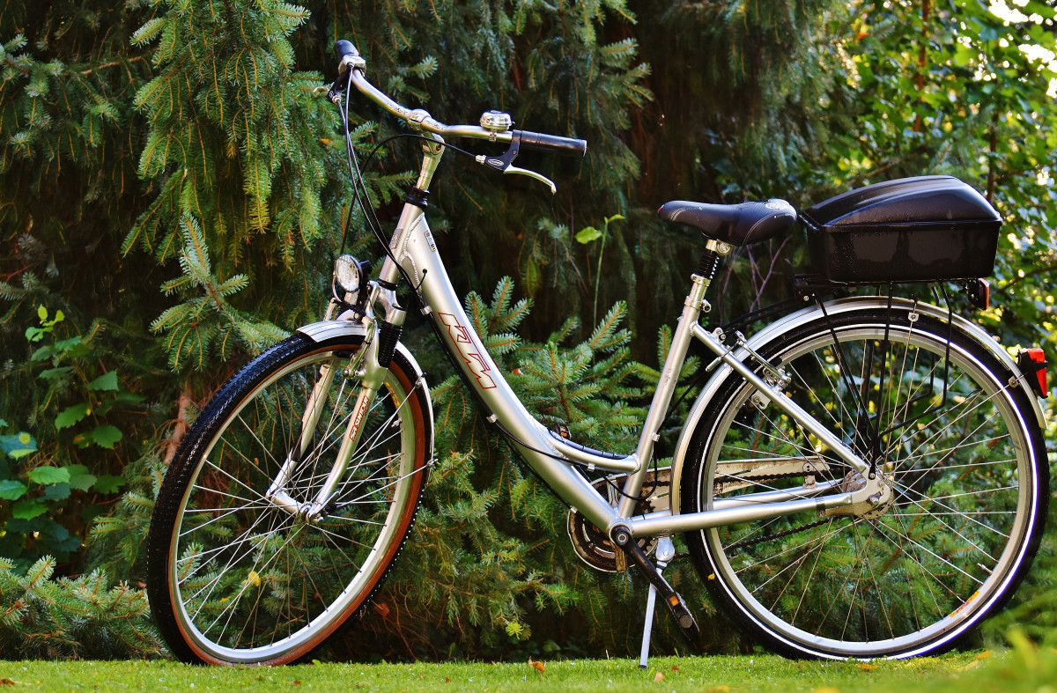
Dashboard Slicers
Regions
Drill down to specific region at a particular time for each product category.
Date
Product Category

Slide 8
Key Performance Indicators
Overall Performance
Total Revenue
Customer
All Customers
Forecast
Uplifted Revenue
YTD Revenue
YTD Analysis
YTD Profit
Buying customers
Customer profile
Total Quantity
Total Profit

Slide 9
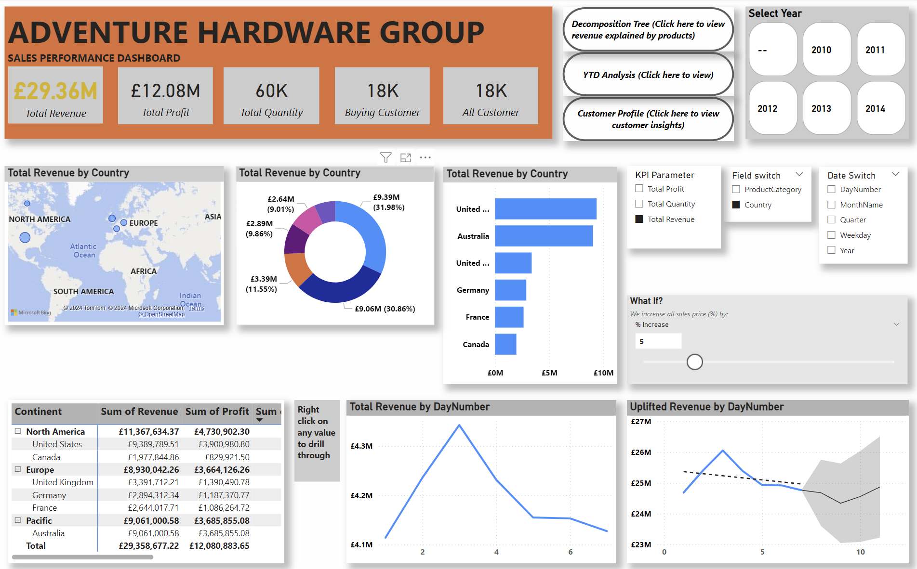
Links to key drivers, customer profile & YTD analysis
Time period Filter
Key performance Indicators
KPI & Product-Location switch Interactivity visuals.
KPI switch
Product-Location switch
Date Switch
Forecast
Table showing KPIs per Region & Profit margin
KPI & Date switch Visual

Slide 11
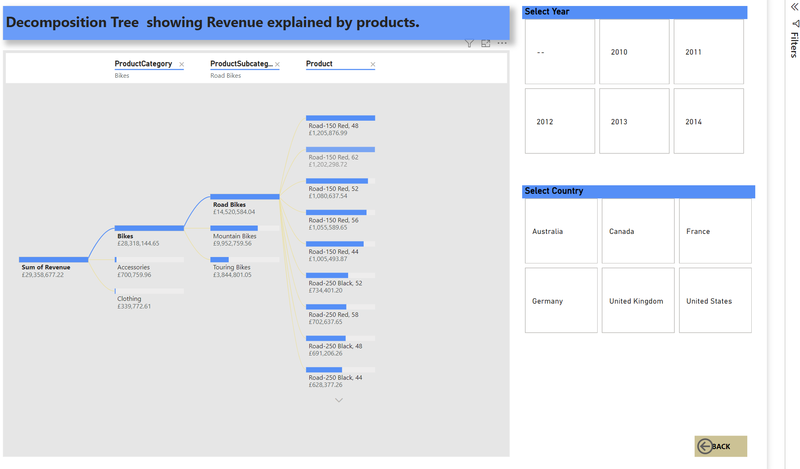
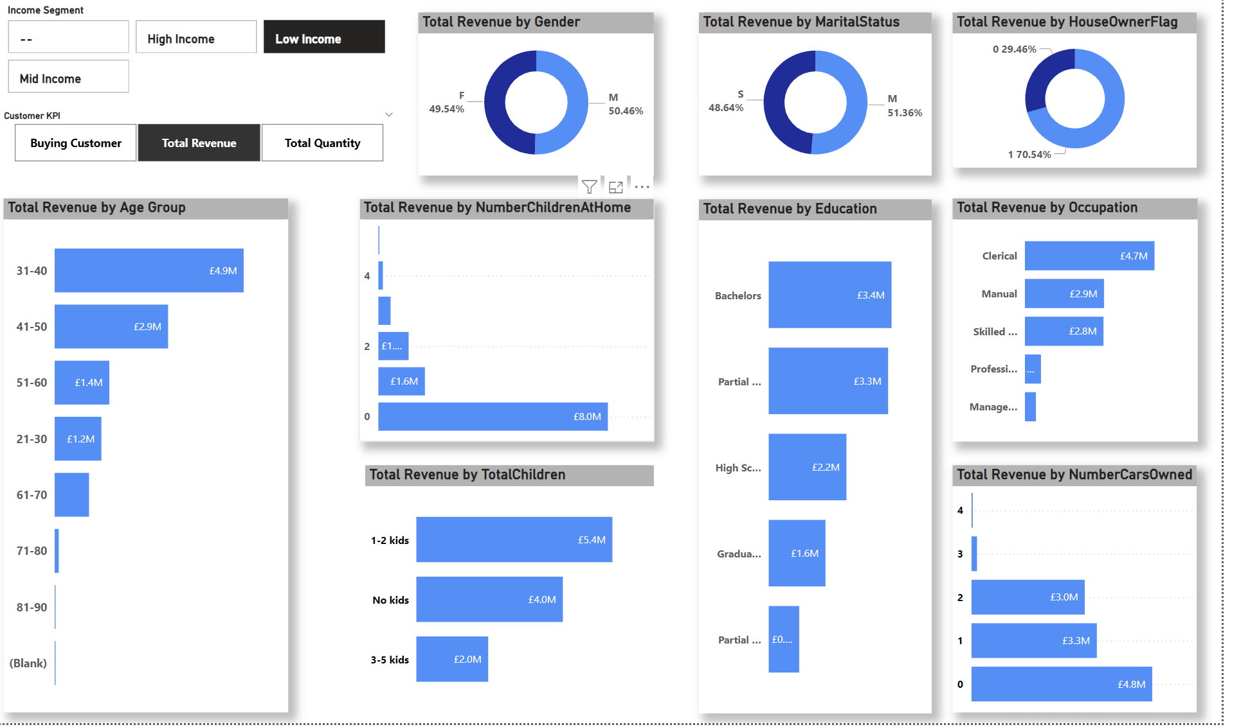
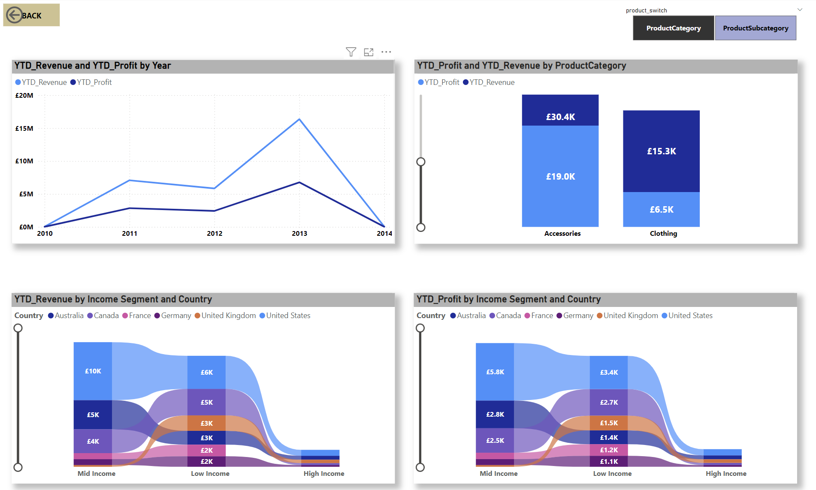
Decomposition tree (Revenue by products)
Customer Profile
YTD Analysis

Slide 12
2. Recommendation Engine

Slide 13

AHG has been selling bikes only online for 2 years (2010 - 2011). The following year (2012) they introduced clothes and accessories as new categories online.
The key focus now is to increase each customer basket value and in turn, increase the revenue and profit from the online channel.
The tool will be able to search for a recommendation list based on a specified user, such that:
Input: customer ID
Returns: ranked list of items, that the customer is most likely to want to put in his/her (empty) “basket” based on customer similarity and item popularity and also: Input : ProductSubCategory Returns: ranked list of items similar to the selected one.

Slide 14
Process Flow
Importing the data from database.
Building the engine.
Testing the model.
Model Output.

Slide 15
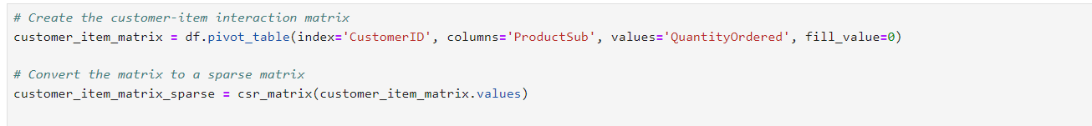
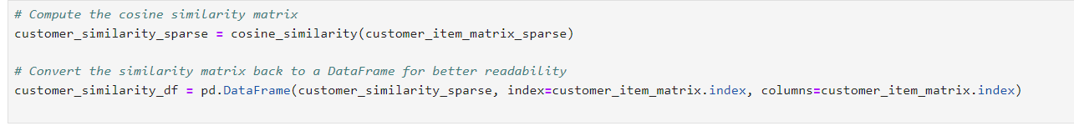
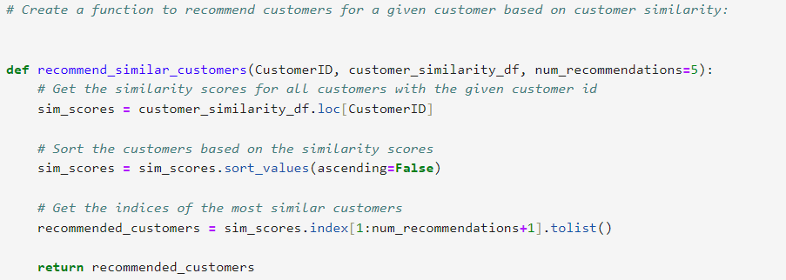
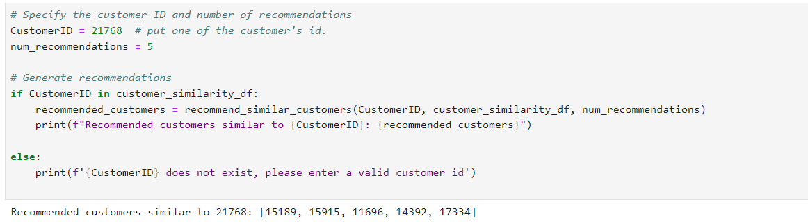
User Based Similarity Approach
In this approach, created a user-item interaction matrix. This matrix will have CustomerID as rows, ProductSubCategory as columns, and QuantityOrdered as values.
A more memory-efficient approach. One option is to use sparse matrices, which store only non-zero elements and save memory. Used the csr_matrix from scipy.sparse for efficient storage and computation.
Cosine similarity matrix was computed which was converted to a dataframe for better readability.
Function to recommend customers for a given customer based on customer similarity was created.
Testing the engine by inputting customer ID

Slide 16
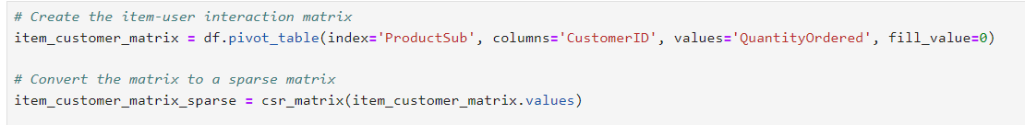
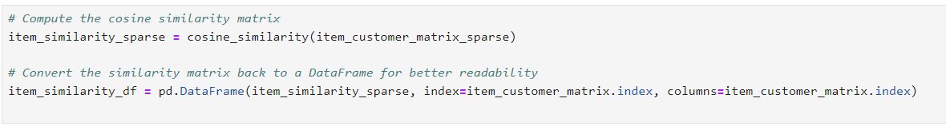
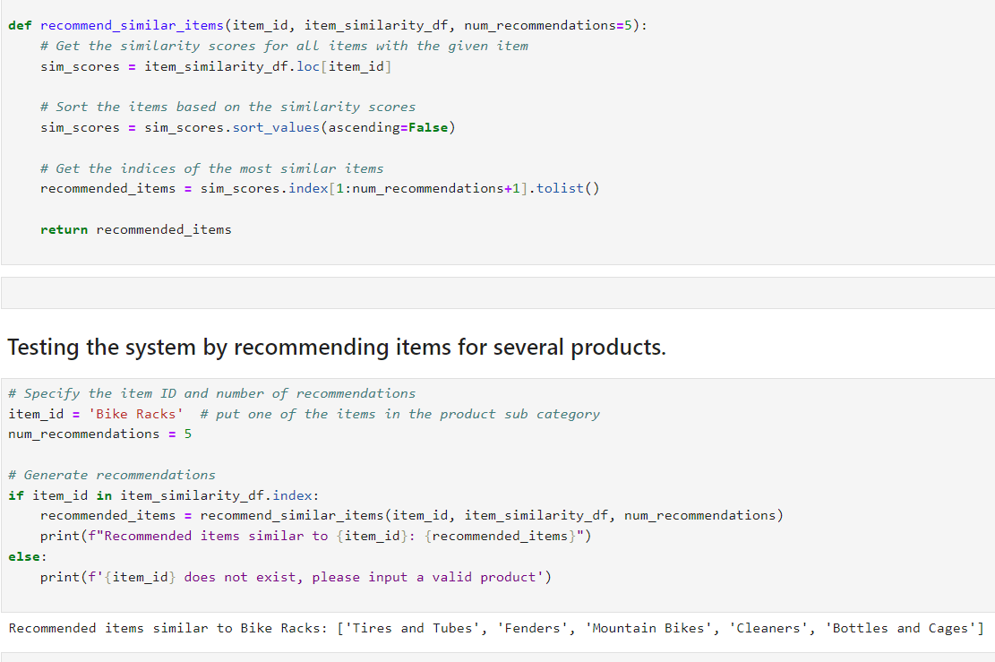
Item Based Similarity Approach
In this approach, created an item-customer interaction matrix. This matrix will have ProductSubcategory as rows, CustomerID as columns, and QuantityOrdered as values.
A more memory-efficient approach was used as in the user based approach.
Cosine similarity matrix was computed which was converted to a dataframe for better readability.
Function to recommend items for a given item based on item similarity was created.
Testing the engine by inputting a product Subcategory.

Slide 17
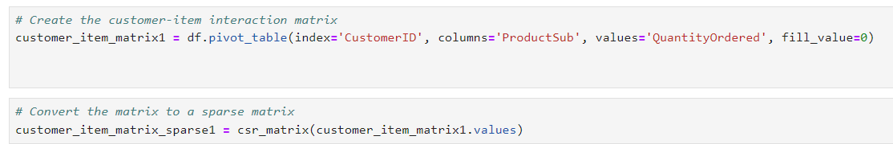
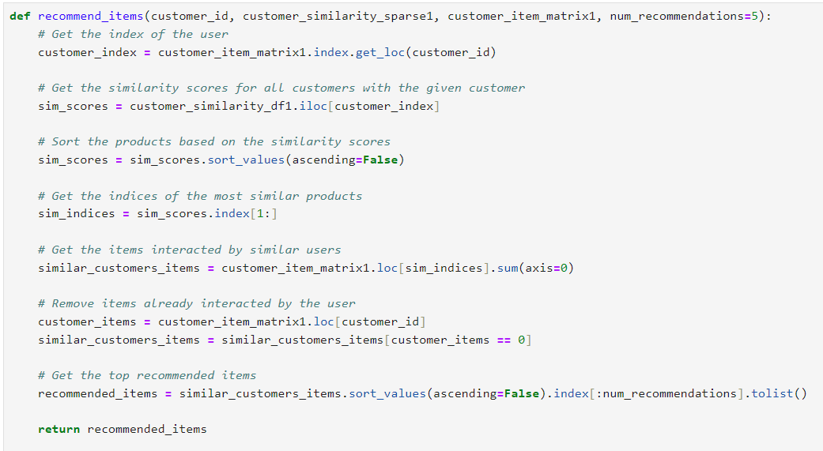
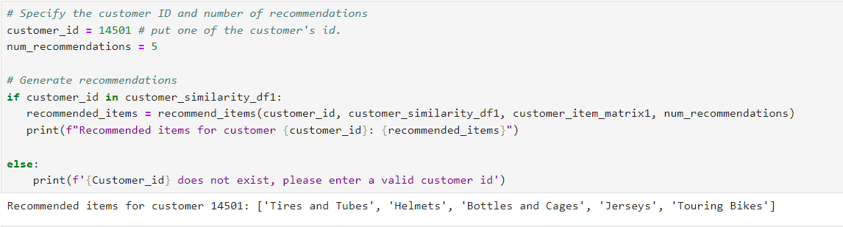
Popularity Based Approach
In this approach, created a user-item interaction matrix. This matrix will have CustomerID as rows, ProductSubCategory as columns, and QuantityOrdered as values.
A more memory-efficient approach was also used.
Cosine similarity matrix was computed which was converted to a dataframe for better readability.
Function to recommend items for a given customer based on item popularity was created.
Testing the engine by inputting a customer Id to recommend top 5 popular ProductSubcategory.

Slide 18
3. Predictive Model.

Slide 19
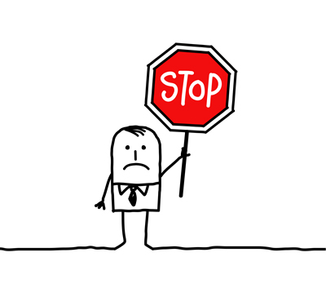
Purpose of a Predictive Model
Of AHG’s 60,398 customer database – 22,423 customers have not made a purchase in the last 8 months which is 37% of the customer database. These are classified as customers who have churned, and impact the profitability of the business. The management needs quantifiable and timely metrics in order to tackle this.
The Predictive Model will find a pattern in the features of customers who have left in the past, and find similar patterns in existing customers, to send alerts if it finds that a customer is potentially going to leave.
This enables the management to take necessary retention measures.

Slide 20
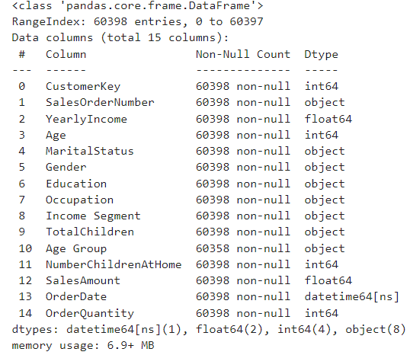
Exploratory Data Analysis
Features from the DimCustomer and FactInternetSales tables were identified to train the model.
Three numerical columns (YearlyIncome, Age & NumofChildren) were categorized for a better exploratory data analysis (IncomeSegment, AgeGroup & TotalChildren)
The following types of data are in the table – 1 datetime, 2 float, 4 integers and 8 objects.

Slide 21
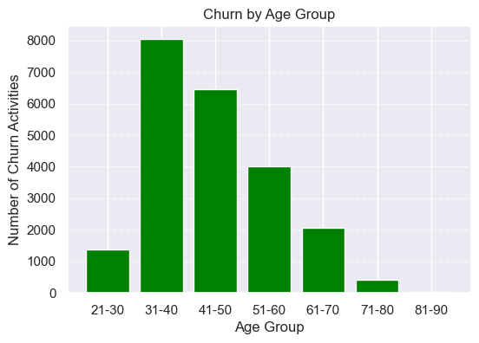
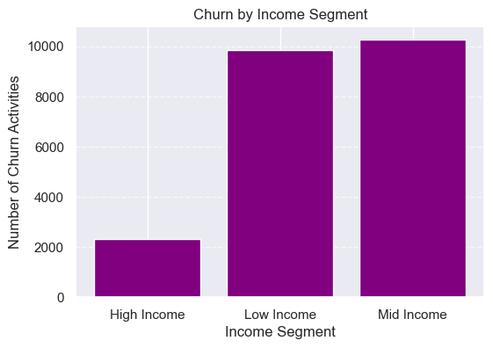
Exploratory Data Analysis based on Churn
Based on the figures from our EDA, 31-40 age group customers and customers with mid income churned most.

Slide 22
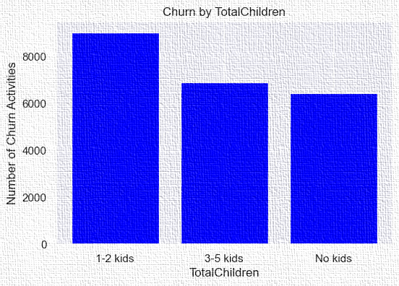
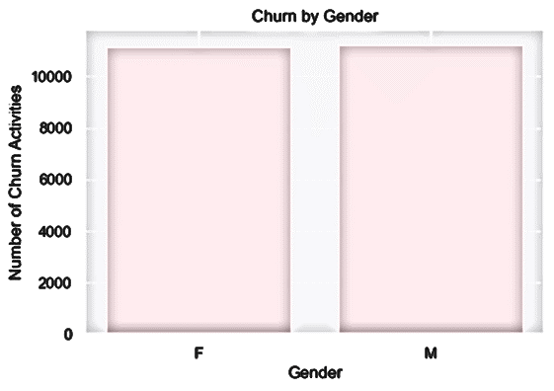
Exploratory Data Analysis based on Churn
Based on the figures from our EDA, customers with 1-2kids and male customers churned most.

Slide 23
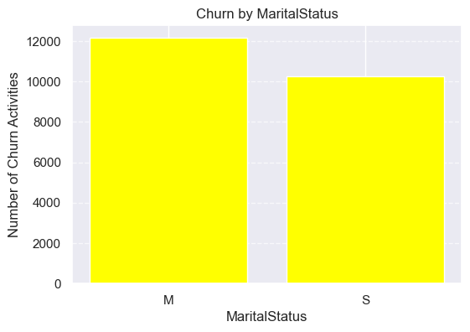
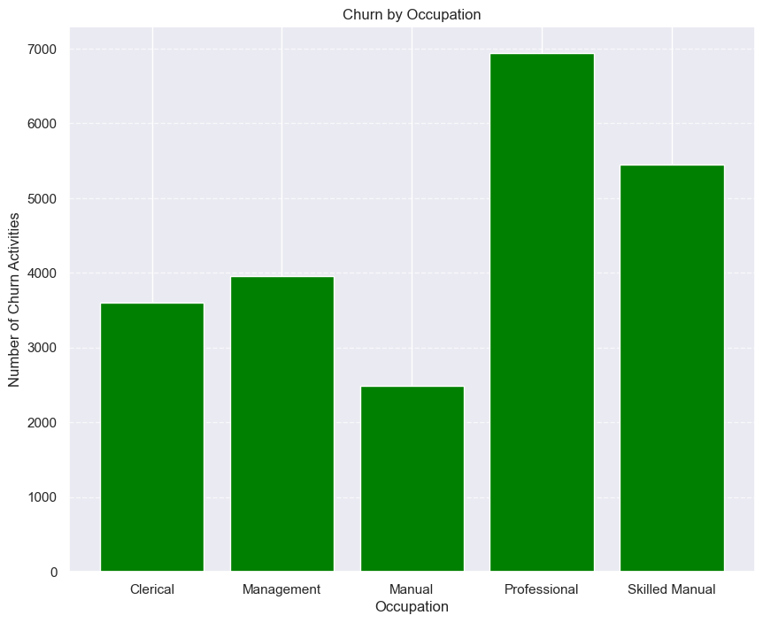
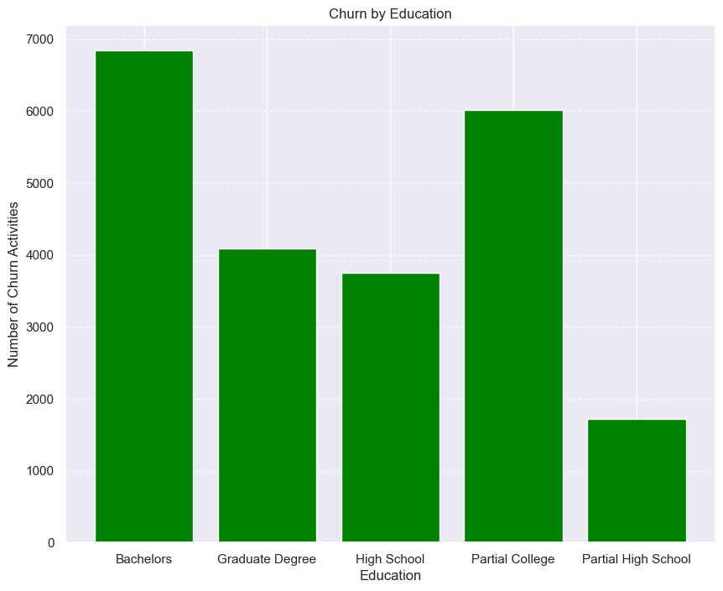
Exploratory Data Analysis based on Churn
Based on the figures from our EDA, married customers, Professional customers and customers with Bachelors education churned most.

Slide 24
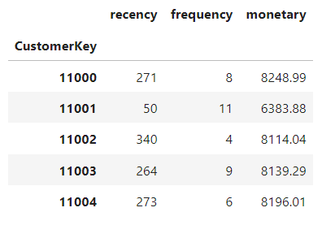
RFM Analysis
To calculate our RFM which is needed as part of the features needed for our model building, we need to calculate our present date, Recency, Frequency and Monetary, following operations were performed:
For Recency - calculated the number of days between present date and date of last purchase for each customer.
For Frequency - calculated the number of orders for each customer.
For Monetary - calculated sum of purchase price for each customer.
Four columns were used to achieve this 'CustomerKey','SalesOrderNumber','OrderDate', 'SalesAmount’.
CustomerKey will uniquely define our customers.
OrderDate help us calculate recency of purchase.
SalesOrderNumber helps to count the number of time transaction performed(frequency) and finally the
SalesAmount which is a product of quantity ordered and unit price used to know our monetary.

Slide 25
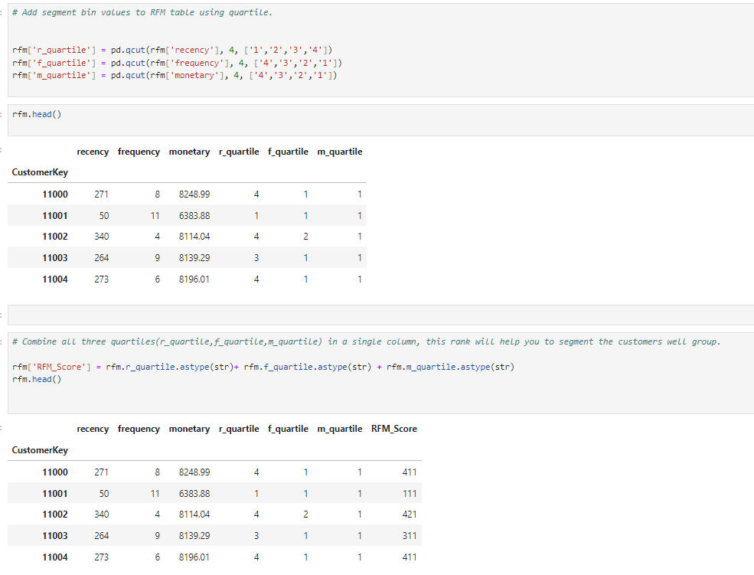
RFM Analysis
Computing Quantile of RFM values
Customers with the lowest recency, highest frequency and monetary amounts considered as top customers.
qcut() is Quantile-based discretization function. qcut bins the data based on sample quantiles. For example, 1000 values for 4 quantiles would produce a categorical object indicating quantile membership for each customer.

Slide 26
Unsupervised Machine Learning.
GOAL: Explore customer data and apply an UNSUPERVISED ML technique to group (cluster) our customers.
Typically this process then feeds into a marketing team to send out TARGETED campaigns to the customers in each cluster.
Our focus is on the calculated RFM scores(recency, frequency, monetary) and our customerID.

Slide 27
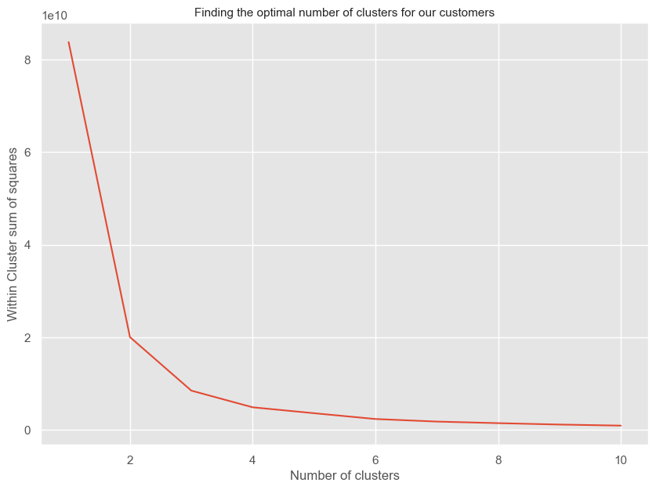
Using the Elbow method to find the optimum number of Clusters. The figure shows a plot variation of WCSS (within cluster sum of squares) for k = 1 to 10 Idea is to look for an INFLECTION point in the "elbow plot" - this is a point on the curve where the rate of change of wcss "slows down“ we will try k=3 first as the rate of change has slowed and k=3 will have a relatively low cost overhead in terms of marketing to these customer groups.

Slide 28
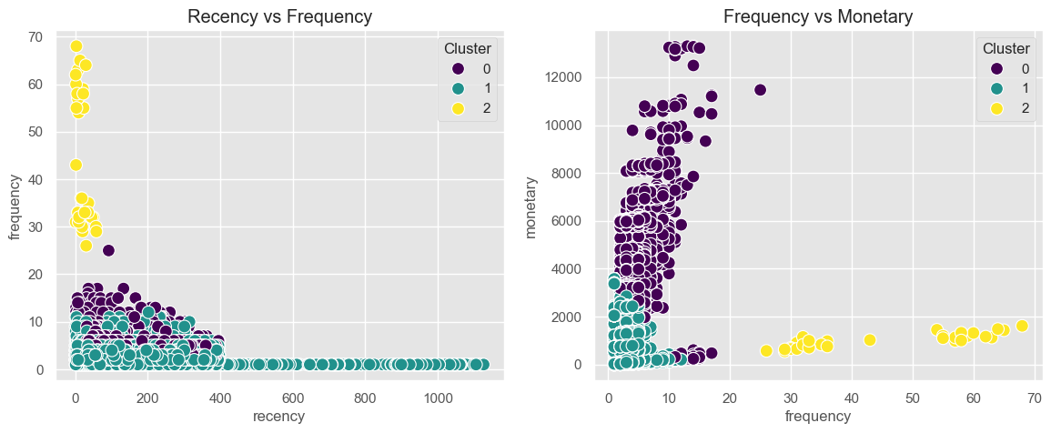
2D scatter plot for each pair of RFM scores for k = 3.

Slide 29
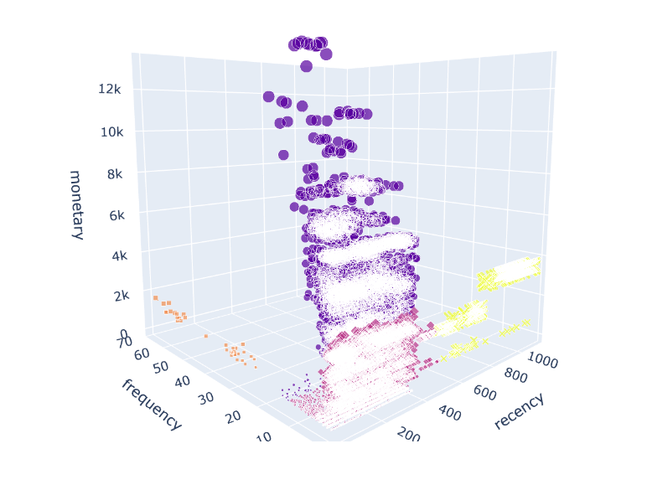
3D scatter plot using Plotly for a better view k = 3.

Slide 30
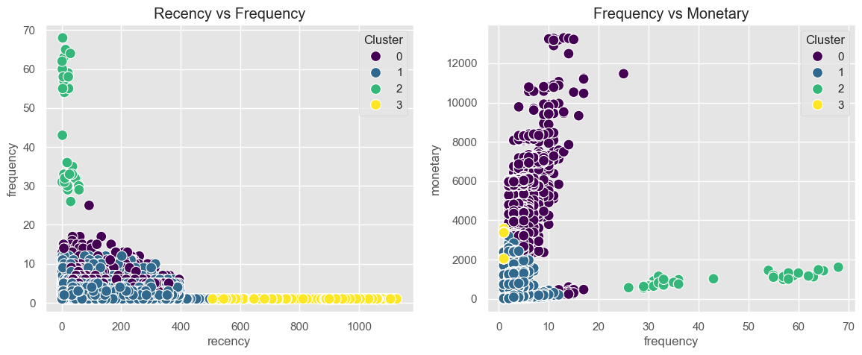
2D scatter plot for each pair of RFM scores for k = 4.

Slide 31
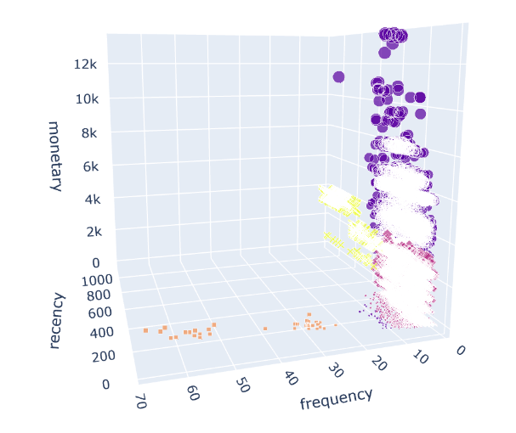
3D scatter plot using Plotly for a better view k = 4.

Slide 32
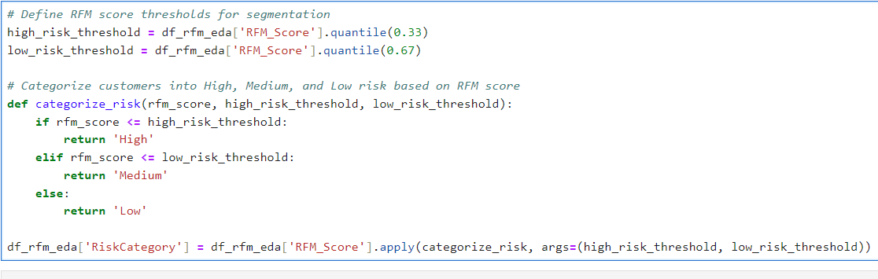
EDA based on the calculated RFM Scores
Threshhold for segmentation was defined:
High_risk_threshold was defined based on 33% quantile of the RFM score while low_risk_threshold was based on 67% quantile of the RFM Score for each customer.
Our focus is on the high risk customers, which was eventually ranked after categorizing our customers into High, Medium, and Low risk based on RFM score.
The ranking was now visualized for each categorical variables based on mean churn rate.
Two categorical variables were also visualized .
This was necessary so as to know the cluster of customers to target.

Slide 33
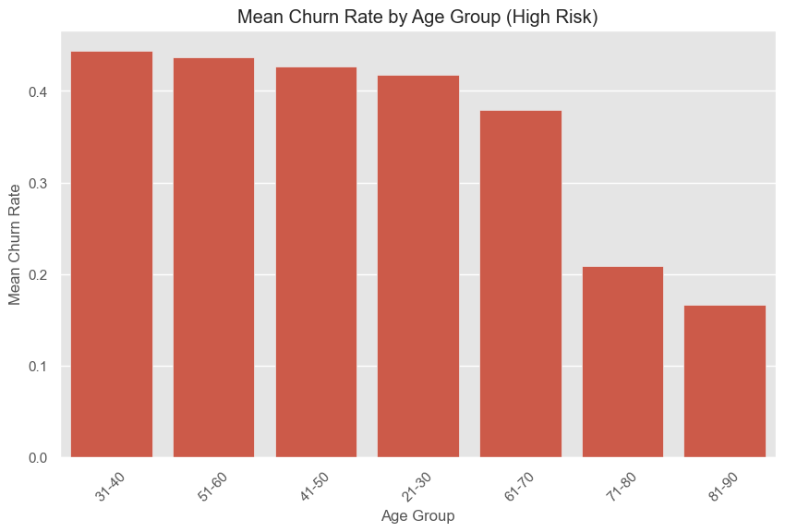
EDA based on the calculated RFM Scores
Age group EDA based on RFM score
From our EDA, the age group with the highest risk of churning is the 31-40 age group.

Slide 34
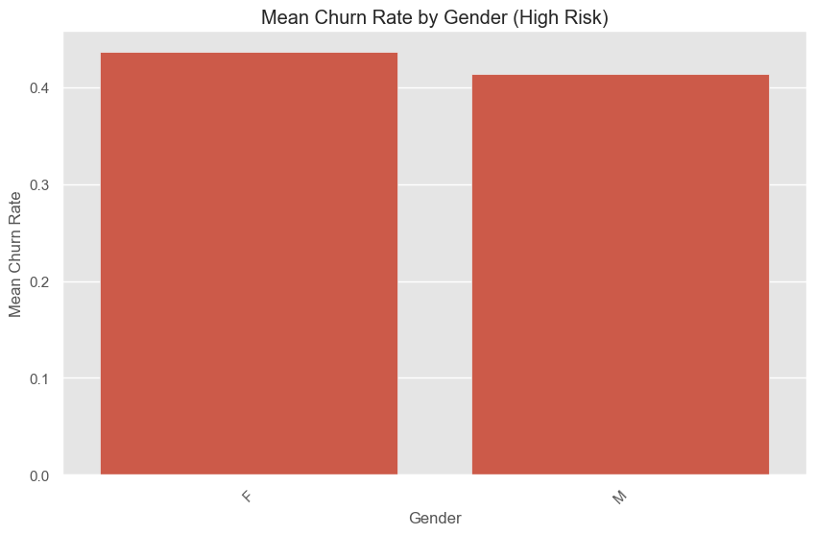
EDA based on the calculated RFM Scores
Gender EDA based on RFM score.
From our EDA, Female customers has the highest risk of churning as against Male customers when analysed based on only churn.

Slide 35
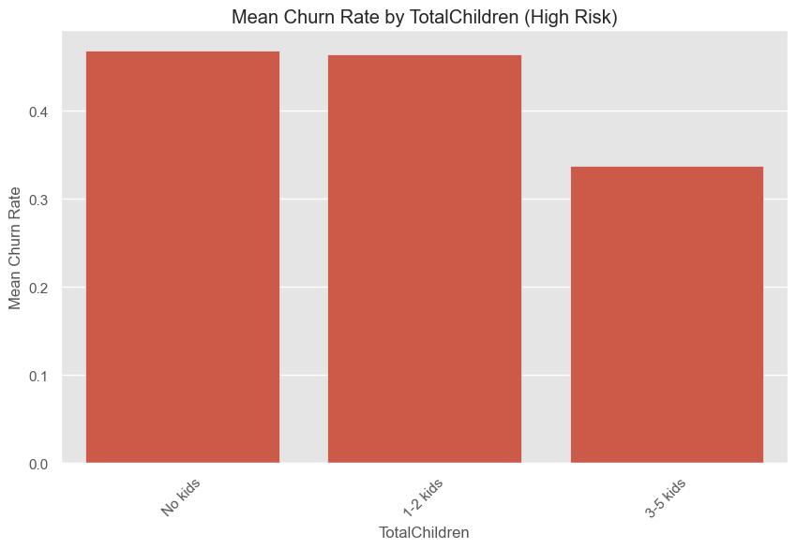
EDA based on the calculated RFM Scores
TotalChildren EDA based on RFM score.
From our EDA, the customers with no kids has the highest risk of churning which is also different from 1-2 kids when analysed based on only churn.

Slide 36
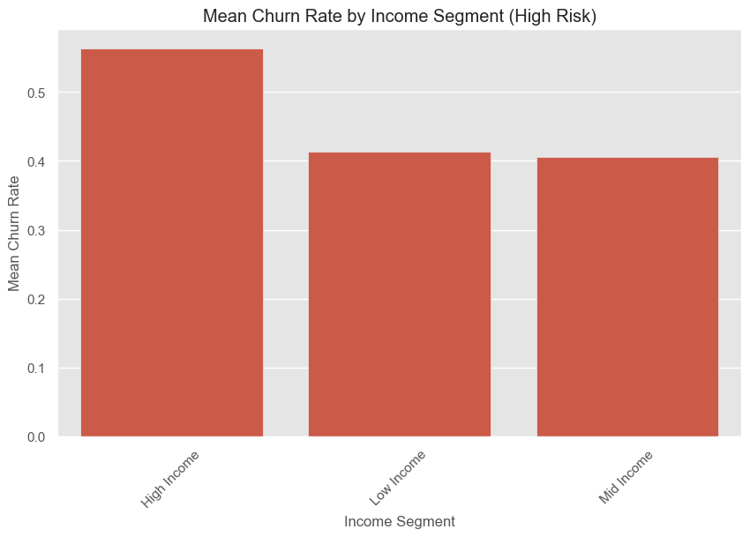
EDA based on the calculated RFM Scores
Income Segment EDA based on RFM score.
From our EDA, the customers with High Income Segment has the highest risk of churning which is also different from Mid Income Segment when analysed based on only churn.

Slide 37
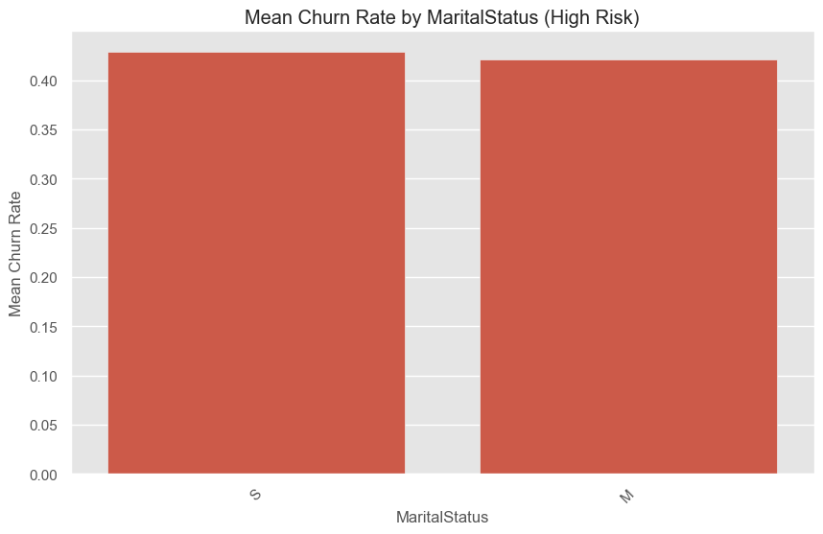
EDA based on the calculated RFM Scores
Marital Status EDA based on RFM score.
From our EDA, the Single customers has the highest risk of churning which is also different from Married Customers when analysed based on only churn.

Slide 38
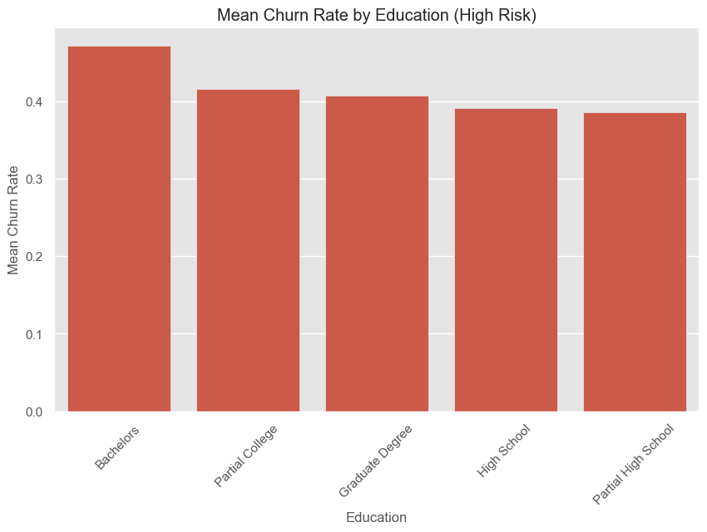
EDA based on the calculated RFM Scores
Education EDA based on RFM score.
From our EDA, the Customers with Bachelors has the highest risk of churning which is not different from when analysed based on only churn.

Slide 39
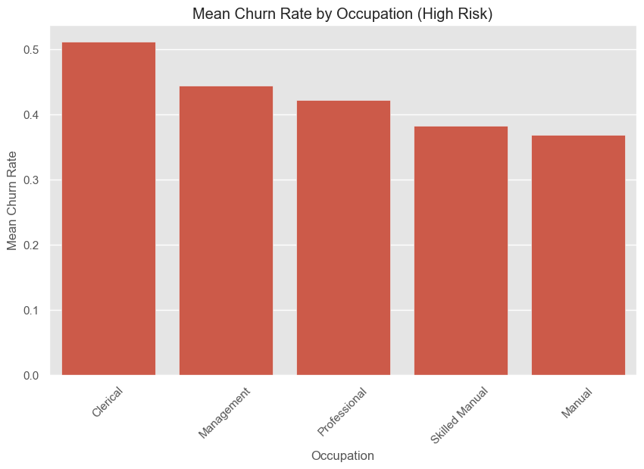
EDA based on the calculated RFM Scores
Occupation EDA based on RFM score.
From our EDA, Clerical customers has the highest risk of churning which is also different from Professional Customers when analysed based on only churn.

Slide 40
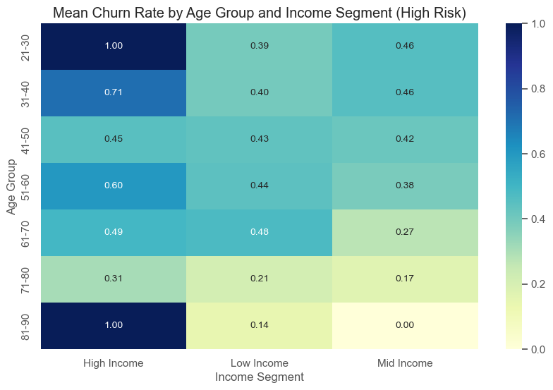
Combining Age Group with Income Segment features.
From the figure,
High Income customers within 21-30 & 81-90 age group are high risk
Low Income customer within 61-70 age group are high risk
Mid income customer within 21-30 & 31-40 age group are high risk.

Slide 41
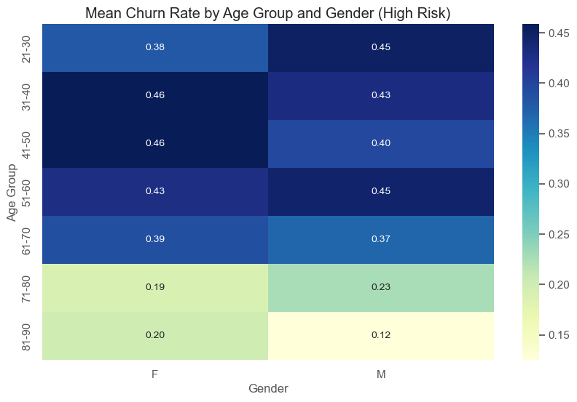
Combining Age Group with Gender features.
From the figure:
Female customers within 31-40 & 41-50 age group are high risk.
Male customers within 21-30 & 51-60 age group are high risk.

Slide 42
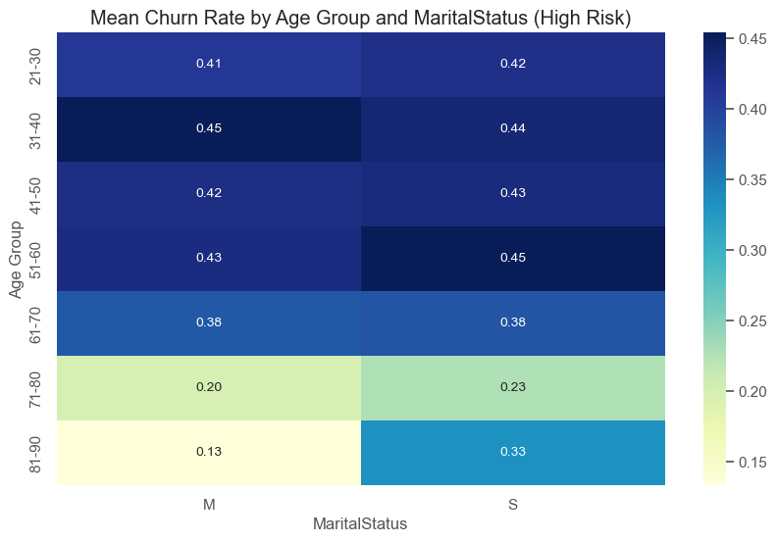
Combining Age Group with MaritalStatus features.
From the figure:
Married customers within 31-40 age group are high risk.
Single customers within 51-60 age group are high risk.

Slide 43
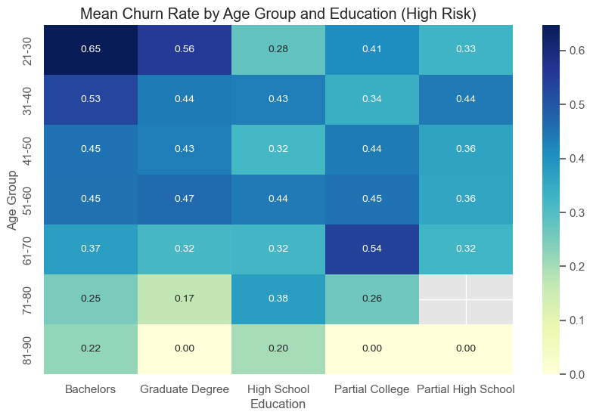
Combining Age Group with Education features.
From the figure:
The main concentration are customers within the age group of 21-30 that has bachelors.

Slide 44
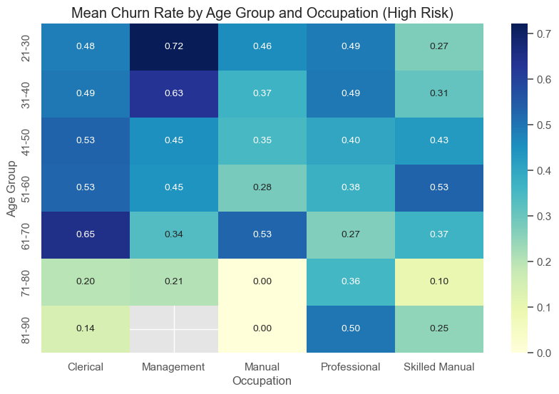
Combining Age Group with Occupation features.
From the figure:
The main concentration here are customers within the age group of 21-30 that are in a managerial occupation followed closely by clerical occupational customers within 61-70 age group.

Slide 45
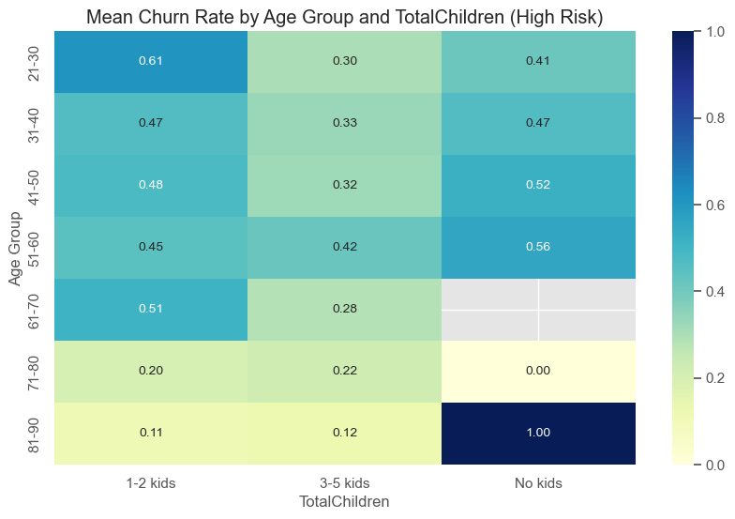
Combining Age Group with TotalChildren features.
From the figure:
The main concentration here are customers within the age group of 81-90 that has no kids at home.

Slide 46
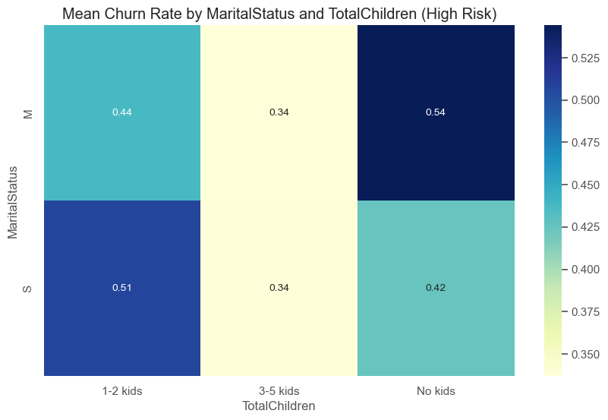
Combining MaritalStatus with TotalChildren features.
From the figure:
Married customers with no kids has the highest risk of churning.

Slide 47
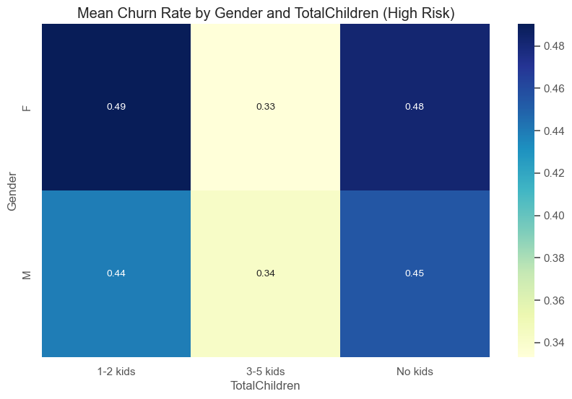
Combining Gender with TotalChildren features.
From the figure:
Female customers with 1-2 kids has the highest risk of churning followed closely by Female with no-kids.

Slide 48
Supervised Machine Learning.
Importing the data from database using SQL
Dataset was divided into churners and non-churners.
Non-churners was divided into 60-40%
40% was concatenated with the churners to form our historical data set while 60% was kept to be used as our live data set.
The historical dataset was used to build our model.
The champion model was used to score our live dataset.
Recommendations made.

Slide 49
Historical Dataset
13,410 total customers
Last order date 28-01-2014
Non Churners – 3,383
Made a purchase after 28-05-2013
Churners – 10,027
Did not make any purchase since 28-05-2013
Dataset Split into train and test
9,387(to train )
4,023 (to test)
Model trained with
9,387 customers

Slide 50
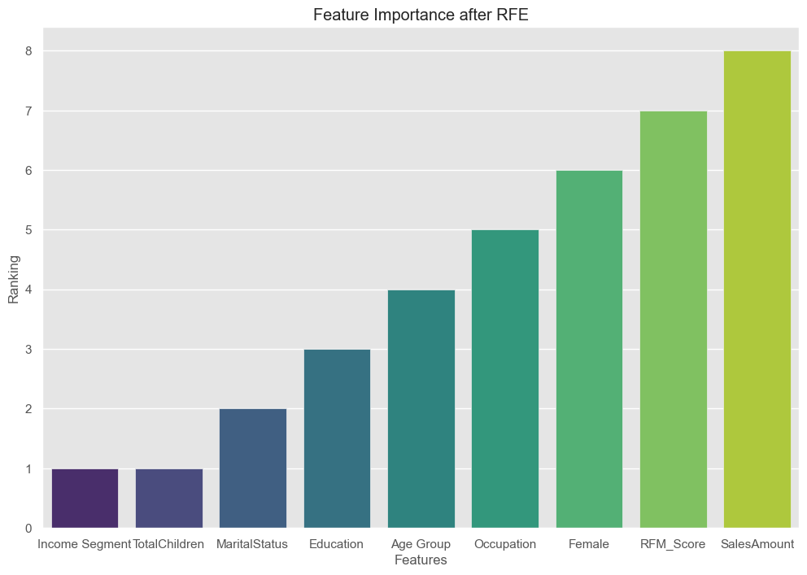
Using Recursive Feature Elimination (RFE) and ranking the features in order of importance.

Slide 51
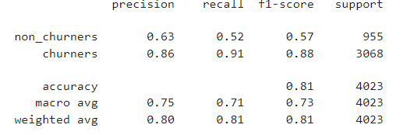
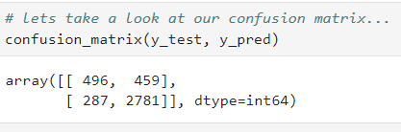
Model Building - Baseline (Run 0-Unscaled data)
Using Logistic Regression Classifier Predictions & Evaluation
Classification Report
The average precision is 0.86
The average recall is 0.91
The f1-score is 0.88
Accuracy is 0.81
Confusion Matrix
Classified correctly as Non - Churners – 496
Classified correctly as Churners – 2,781
Classified incorrectly as Non - Churners –287
Classified incorrectly as Churners -459

Slide 52




Model Building – Run 1(Scaled data)
Using Logistic Regression Classifier Predictions & Evaluation
Classification Report
The average precision is 0.86
The average recall is 0.91
The f1-score is 0.88
Accuracy increased a little to 0.82
Confusion Matrix
Classified correctly as Non - Churners – 495
Classified correctly as Churners – 2,786
Classified incorrectly as Non - Churners –282
Classified incorrectly as Churners -460
ROC(Receiver Operating Characteristic)

Slide 53


Resampling
Before
After
Our historical data has a highly imbalanced target label, it has more churners than non churners which is making our model to be biased towards the churners despite having a very good accuracy.
The target is HIGHLY imbalanced – had to do some more sophistcated techniques (e.g. under-sampling of minority class) undersampling the minority class (churners): Our historical dataset has more churners than non churners which would make our model bias towards churners. Typically, in a churn dataset, it is common to have far fewer churners than non-churners, so it makes sense to under-sample the minority class so as to have a good model.
I decided to under sample the minority class (Churners) is to keep the integrity of the dataset rather than adding synthetic datas to my dataset. This made me have a BALANCED target.
Our model was also built using all the features, we will now go ahead to build our model based on features selected by RFE to be elimitated after resambling

Slide 54

Parallel Model Run
Random Forest was our champion model after the parallel model run.
RF was eventually used to build the model.

Slide 55

Random Forest Model Building Output
Best Parameters, Best Estimator, Accuracy and the classification report is shown below:

Slide 56



Random Forest Model Building Output
Using Random Forest Predictions & Evaluation
Classification Report
The average precision is 0.97
The average recall is 0.90
The f1-score is 0.94
Accuracy is 0.94
Confusion Matrix
Classified correctly as Non - Churners – 657
Classified correctly as Churners – 614
Classified incorrectly as Non - Churners –66
Classified incorrectly as Churners - 17

Slide 57

Result after Scoring of Live Dataset
The Saved model was used to score the data set.
After scoring, 2,089 was predicted to churn out of 5,074 which is 41.17%
Average Revenue per customer was also calculated to £385.61 which is shown in the violin plot in the figure.

Slide 58

Commercial Impact of Churn
Customers scored – 5,074
Customers likely to churn – 2,089 (41.17%)
Customers likely to stay – 2,985 (58.83%)
Average revenue per customer per year- £385.61
Total revenue loss from customers likely to churn per year is £793,581

Slide 59

Recommendations to Prevent Customer Churn
Identify customers that are likely to churn based on the EDA with RFM score done earlier on a weekly basis. Any customer within those categories that has not purchased items over the last 5 months is to be classified as a churner or non-churner.
Upon identifying a potential churner, email/post a promotional voucher or discount coupon
Identify recommended product from the recommendation model and send related promotions to the buyer.
Ask for feedback and recommendations on product range + specification from customer to engage and revive them.

Slide 60



Thank you
Oluwaseun Bamgbose (BSc. PMP)
oluwaseun.bamgbose37@gmail.com
07867283031

